Slide 1
Complications of Fractures
PRESENTER:
DR. SITATI
Consultant Orthopedic Surgeon
MBChB, Mmed(Ortho), FCS, Dip SICOT

Slide 2
COMPLICATIONS OF FRACTURES
General
Local
Shock -
Venous Thrombosis Pulmonary Embolism
Tetanus
Gas gangrene
Fat Embolism
Early
Delayed union
Non-union
Malunion
Joint stiffness
Myositis ossificans
Avascular necrosis
Algodystrophy (RSD)
Osteoarthritis
Late
Local Visceral Injury
Vascular Injury
Nerve Injury
Compartment Syndrome
Haemarthrosis
Infection
Gas gangrene
Joint instability
Muscle contracture
Growth disturbance
Bed sores

Slide 3
General Complications

Slide 4
General Complications
Shock - internal or external
Venous Thrombosis and Pulmonary Embolism
Tetanus
Gas gangrene
Fat Embolism

Slide 5
LOCAL: Early Complication
Local Visceral Injury
Vascular Injury
Nerve Injury
Compartment Syndrome
Haemarthrosis
Infection
Gas gangrene

Slide 6
LOCAL :LATE COMPLICATIONS
Delayed union
Non-union
Malunion
Joint stiffness
Myositis ossificans
Avascular necrosis
Algodystrophy (RSD)
Osteoarthritis
Joint instability
Muscle contracture
(Volkmann’s contracture)
Tendon lesions
Growth disturbance
Bed sores

Slide 7
Venous thrombosis & Pulmonary Embolism
One of the commonest Complications of Trauma & Surgery
Most frequent sites (DVT):
Calf
Less in proximal thigh & pelvis
Pulmonary Embolism
From Proximal of thigh & pelvis

Slide 8
Causes of DVT
Virchow’s Triad
HYPERCOAGULABILITY of the Blood
Stasis
Endothelial damage

Slide 9
High risk group
Old people
Cardiovascular Disease
Bed ridden patient
Patients undergoing hip or knee arthroplasty

Slide 10
Clinical features of DVT
Pain the calf or thigh
Soft tissue tenderness
increase in temperature
increase in pulse rate
Homann’s Sign positive

Slide 11
Diagnosis of DVT
Ascending venography
Doppler technique

Slide 12
DVT treatment
Bed rest
Elastic stockings
Full anticoagulation - subcut heparin

Slide 13
Pulmonary embolism
Difficult to diagnose
Only minority have symptoms (chest pain, dyspnoe, heamoptysis)
Diagnosis:
Chest CT Scan
Pulmonary angiography

Slide 14
PE Prevention
Prophylactic treatment
Foot elevation
Graduated compression stockings
Exercise
Anticoagulant treatment
Subcut low dose heparin

Slide 15
Pulmonary Embolism treatment
Vasopressor for shock
Oxygen
Large dose heparin
Streptokinase (dissolve clot)
Antibiotics (prevent lung infection)

Slide 16
TETANUS
Tetanus organism live only in dead tissue→exotoxin →blood & lymph to CNS →anterior horn cell
Will develop
Tonic clonic contraction
Jaw and face (trismus and risus sardonicus)
Neck and trunk
Diaphragm and Intercostal muscle →spasm→ASPHYXIA

Slide 17
Tetanus Prophylaxis
Active immunization (tetanus toxoid)
Booster doses (immunized patients)
Non Immunized patients
Surgical toilet & antibiotics
If wound contaminated →antitoxin

Slide 18
Treatment for Tetanus
IV antitoxin
Heavy Sedation
Muscle Relaxant drug
Tracheal Intubation
Controlled respiration

Slide 19
GAS GANGRENE
By clostridial infection (esp C.welchii)
Anaerobic with low oxygen tension
Produce toxins→destroy cell wall→tissue necrosis →Spreading

Slide 20
The clinical features
Within 24 hours
Intense pain
Swelling
Brownish discharge
Pulse rate increased
Charasteristic smell
Little or no pyrexia
Toxaemic→coma→DEATH

Slide 21
Prevention
Deep penetrating wound should be EXPLORED
ALL dead tissue →completely EXCISED
Doubt about tissue viability→leave it OPEN

Slide 22
Treatment for gas gangrene
The key = EARLY DIAGNOSIS
General measures (fluid, IV antibiotics)
Hyperbaric oxygen (limiting spread)
Removal of all dead tissue
Amputation (advanced case)

Slide 23
FAT EMBOLISM
Source of fat emboli=bone marrow
Usually in MULTIPLE CLOSED FRACTURES

Slide 24
Suspect in
Usually young adults with LL fracture
Features:
Breathlessness
Mild mental confusion
Petechia (chest & conjuntival fold)

Slide 25
Treatment
Mild case
Give Oxygen
Severe
Intensive care with sedation and assisted ventilation
Fluid balance
Supportive
Heparin-thromboembolism
Steroids-pulmonary oedema
Aprotinin-prevent aggregation of chylomicrons

Slide 26
COMPLICATION OF FRACTURE
General
Local
Early
Late
* Early complication : those that arise during the first few weeks
following injury.

Slide 27
Early Complication
Local Visceral Injury
Vascular Injury
Nerve Injury
Compartment Syndrome
Haemarthrosis
Infection
Gas gangrene

Slide 28
Local visceral Injury
Fracture around the trunk are often Cx by injury to the adjacent viscera :
Pelvic fracture
Rib fracture penetration to the lungs
Bladder and urethral
rupture
Pneumothorax
Notes:
These require Emergency Treatment…………chest tube insertion

Slide 29
Vascular injury
Most commonly – knee, femoral shaft, elbow, and humerus.
Artery may be cut, compressed or contussed.
↓↓ bld flow → Ischemia leads to tissue death & peripheral gangrene
Notes:
Most common artery injury is popliteal art
Knee – poppliteal artery, femoral art, brachial art…….cut, torn – by initial inj or jagged by bone fragments

Slide 30
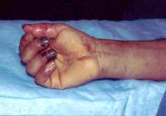

Slide 31
Clinical features
Pt with ischemia may have 5 P’s:
- paraesthesia/numbness
- pain
- pallor
- pulselessness
- paralysis
Investigate if suspect vascular injury : Angiogram

Slide 32
Treatment
Emergency
All bandages/splints removed
Circulation reassessed for next half hour
If no improvement, do vessels exploration
Suture torn vessels, vein grafting, if thrombosed do endarterectomy
Aim: to restore bld flow
Notes:
In this operation, the fracture can be fixed internally at the same time

Slide 33
Nerve Injury
Variable degree of motor and sensory loss along the distribution of the nerve
May be neurapraxia, axonotmesis or neurotmesis
Radial nerve is most frequently damaged nerve.
Notes:
Radial N – Humerus fracture
Neurapraxia-minimal damage, axonotmesis- axon damage but sheath intact, neurotmesis- complete damage

Slide 34
Nerve | Trauma | Effect
Axillary | Dislocation of shoulder | Deltoid paralysis
Radial | # of humerus | Wrist drop
Median | Supracondylar # of humerus | Pointing index
Ulnar | # medial epicondyl humerus | Claw hand
Sciatic | Post dislocation of hip | Foot drop
Common peroneal | Knee dislocation # neck of fibula | Foot drop

Slide 35
Compartment Syndrome
Definition
Compartment syndrome involves the compression of nerves and blood vessels within an enclosed space, leading to impaired blood flow and nerve damage.
Notes:
If blood supply is impaired more than 12 hours, coz necrosis of the muscles and nerves within the compartments. Nerve is still capable of regeneration but muscles once infarcted, can never recover n will be replaced by inelastic fibrous tissue.(volkmann’s contracture)

Slide 36
Causes:
-any injury/infection leading to edema of muscle
-fracture haematoma
-Due to tight bandages or casts
Hallmark Symptoms:
- severe pain that does not respond to elevation or pain medication.
- In more advanced cases, there may be decreased sensation, weakness, and paleness of the skin.

Slide 37
Injuries with a high risk of developing Compartments synd:
# of the elbow
# of the forearm bone
# of the proximal third of the tibia

Slide 38
Early preventing : limb elevation
Dx : confirmed by direct intracompartmental pressure measuring > 40mmHg .
Notes:
As ischemic muscles is sensitive to stretch,
Different pressure btwn diastolic pressure and compartment pressure
Within 6 hour in total ischema…muscles necrosis

Slide 39
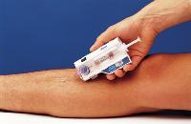

Slide 40
Treatment
First removed all the bandages & dressing.
Fasciotomy is performed.
Notes:
Fasciotomy :do a long incision to the fascia to release the pressure

Slide 41
Haemarthrosis
Occurs in fractures involvg joints, leads to acc. of blood within the joints.
C/Feature :The joint is swollen and tense and patient will resists any movement.
Tx : the blood should be aspirated before dealing with the fracture.

Slide 42
Infection
Causes:
Open fracture (common)
Use of operative method in the Tx of #
Leads to chronic osteomyelitis →union will be slow and ↑ chance of refracturing.
Notes:
un

Slide 43
Treatment:
Antibiotic
Excising all devitalised tissue
Notes:
All open fracture shud be regarded as potentially infecte

Slide 44
LATE COMPLICATIONS
Delayed union
Non-union
Malunion
Joint stiffness
Myoisitis ossificans
Avascular necrosis
Algodystrophy
Osteoarthritis
Joint instability
Muscle contracture
(Volkmann’s contracture)
Tendon lesions
Nerve compression
Growth disturbance
Bed sores

Slide 45
DELAYED UNION
Fracture takes more than the usual time to unite.
Causes
Inadequate blood supply
Severe soft tissue damage
Excessive traction
Insufficient splintage
Infection

Slide 46
PERKINS’ TIME TABLE
 | Upper Limb | Lower Limb
Callus visible | 2-3 wks | 2-3 wks
Union | 4-6 wks | 8-12 wks
Consolidation | 6-8 wks | 12-16 wks

Slide 47
Clinical features
Fracture tenderness
X-Ray
Visible fracture line
Very little callus formation or
periosteal reaction

Slide 48
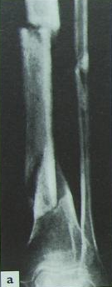
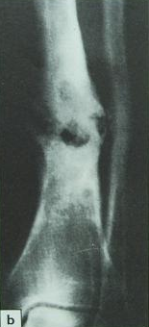
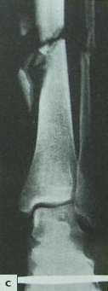
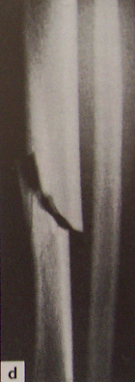
Severe soft tissue damage
Infection
Excessive traction
Intact fibula

Slide 49
Treatment
Conservative
- To eliminate any possible cause
- Immobilization
- Exercise
Operative
- Internal fixation & bone grafting

Slide 50
NON-UNION
Condition when the fracture will never unite w/o intervention
Healing has stopped.
Fracture gap is filled by fibrous tissue (pseudoarthrosis)

Slide 51
Clinical features
Painless movement at the fracture site
X-Ray
Fracture is clearly visible
Fracture ends are: tapered or have excess bone formation

Slide 52
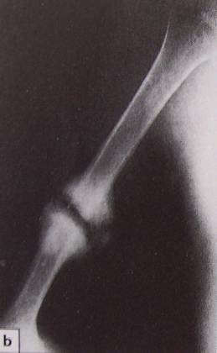
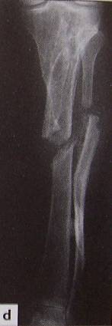
Hypertrophic non-union
Atrophic non-union

Slide 53
Treatment
Hypertrophic non-union
→ Rigid fixation sometimes need bone grafting
Atrophic non-union
→ Fixation & bone grafting

Slide 54
MALUNION
Condition when the fragments join in an unsatisfactory position (unaccepted angulation, rotation or shortening)
Causes
Failure to reduce a fracture adequately
Failure to hold reduction while healing proceeds
Gradual collapse of comminuted or osteoporotic bone.

Slide 55
Clinical features
Deformity & shortening of the limb
Limitation of movements
Treatment
Angulation in a long bone (> 15 degrees)
→ Osteotomy & internal fixation
Marked rotational deformity
→ Osteotomy & internal fixation
Shortening (> 3cm) in 1 of the lower limbs
→ A raised boot OR
Bone operation

Slide 56
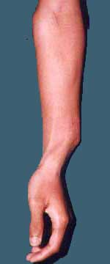
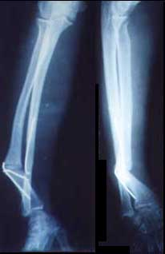
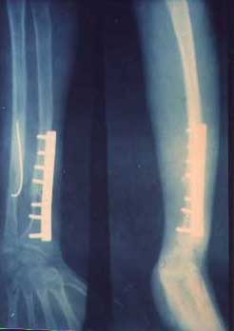
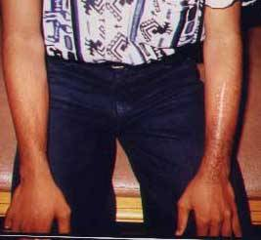

Slide 57
JOINT STIFFNESS
Common complication of fracture Tx following immobilization
Common site : knee, elbow, shoulder,
small joints of the hand

Slide 58
Treatment
Prevention :
- Exercise
- If joint has to be splinted → Make sure in correct position
Joint stiffness has occurred:
- Physiotherapy
- Intra-articular adhesions
→ Gentle manipulation under anaesthesia
- Adherent or contracted tissues
→ Released by operation

Slide 59
MYOSITIS OSSIFICANS
Heterotopic ossification in the muscles after an injury
Usually occurs in
Dislocation of the elbow
A blow to the brachialis / deltoid / quadriceps

Slide 60
Clinical features
Pain, soft tissue tenderness
Local swelling
Joint stiffness
Limitation of movements
Extreme cases: -Complete loss of movement
X-Ray
Normal
Fluffy calcification in the soft tissue

Slide 61
Treatment
Early stage : Joint should be rested
Then : Gentle active movements
When the condition has stabilized :
Excision of the bony mass
Anti-inflammatory drugs may ↓ joint stiffness

Slide 62
AVASCULAR NECROSIS
Circumscribed bone necrosis
Causes
Interruption of the arterial blood flow
Common site :
Femoral head
Femoral condyls
Humeral head
Capitulum of humerus
Scaphoid (proximal part)
Talus (body)
Lunate

Slide 63
Conditions a/w AVN
Certain fractures
Alcohol abuse
High-dosage corticosteroid
Sickle cell disease
Caisson disease
Gaucher’s disease
Perthes’ disease

Slide 64
Clinical features
Joint pain, stiffness, swelling
Restricted movement
X-Ray
↑ bone density
Subarticular fracturing
Bone deformity

Slide 65
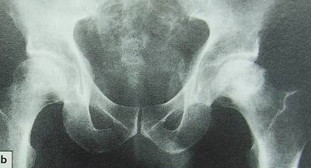
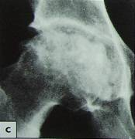
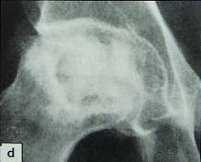
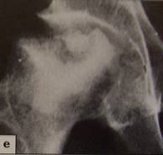

Slide 66
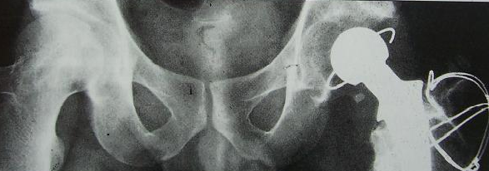
Treatment
Avoid weight bearing on the necrotic bone
Revascularisation (using vascularised bone grafts)
Replacement by prostheses

Slide 67
ALGODYSTROPHY (COMPLEX REGIONAL PAIN SYNDROME)
Previosly known as Sudeck’s atrophy
Post-traumatic reflex sympathetic dystrophy
Usually seen in the foot / hand
Clinical features
Continuous, burning pain
Early stage : Local swelling, redness, warmth
Later : Atrophy of the skin, muscles
Movement are grossly restricted

Slide 68
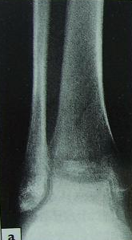
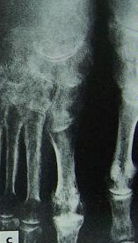
X-Ray
Patchy rarefaction of the bones (patchy osteoporosis)
Osteoporosis
Algodystrophy

Slide 69
Treatment
Physiotherapy (elevation & active exercises)
Drugs
- Anti-inflammatory drugs
- Sympathetic block or sympatholytic drugs
(Guanethidine)

Slide 70
OSTEOARTHRITIS
Post-traumatic OA
Joint fracture wt severely damaged articular cartilage
Develops within months.

Slide 71
The End

